Slide 1
CW Debugging over Simulator / CFP
Presenter :
Sudhanshu Gupta

Slide 2
Entry Points for Images
Linux Image Entry Point
break _text
uBoot Image Entry Point
break main_loop
Note : We come here after U-Boot is initialised and ready to process commands
PPA Image Entry Point
break ???

Slide 3
Adding Symbol Table (uBoot / Linux)

Slide 4
Environment Setup
Open Simulator
Start Simulator model in Debug Mode (-G option in cmd line). Simulator will stop at Reset Address (0x00)
Open Code Warrior IDE
Make copy of project specific configuration in “Target Connections” tab. E.g. LS1028A_Simulator_Demo
Start debugging session. CW IDE attaches to Simulator instance over IP and halt at reset address. (0x00)
Add breakpoints / watch variables [Optional]
Add path to source code (uboot / linux) [Optional]
Press “Resume” (F8) to start bootup.

Slide 5
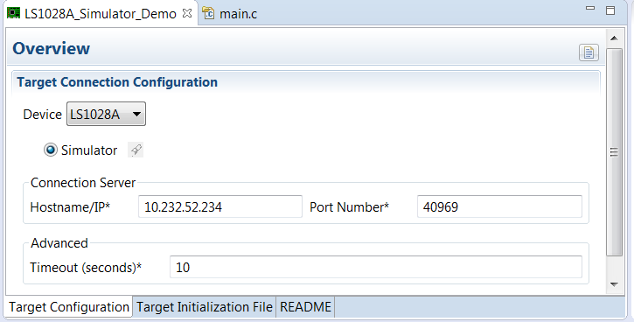
Configuring CW for Simulator (Hostname : Port Number)

Slide 6
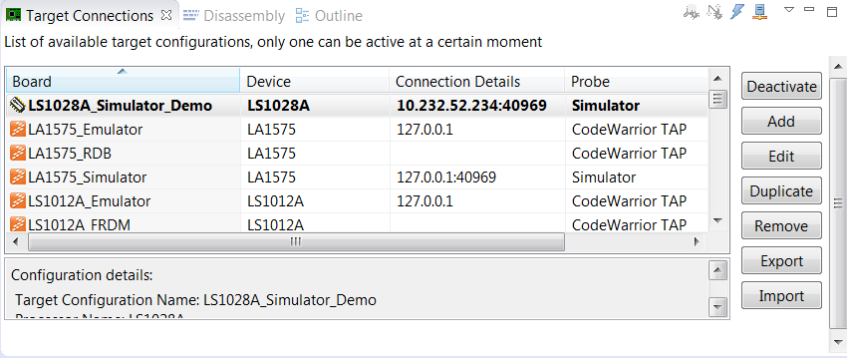
Creating Copy of Project Specific Config

Slide 7
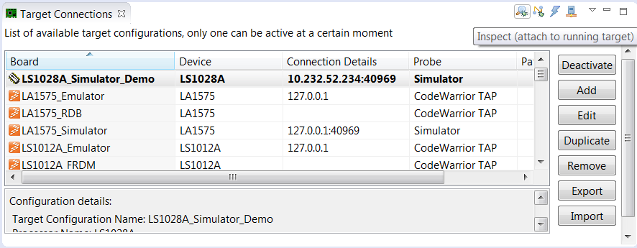
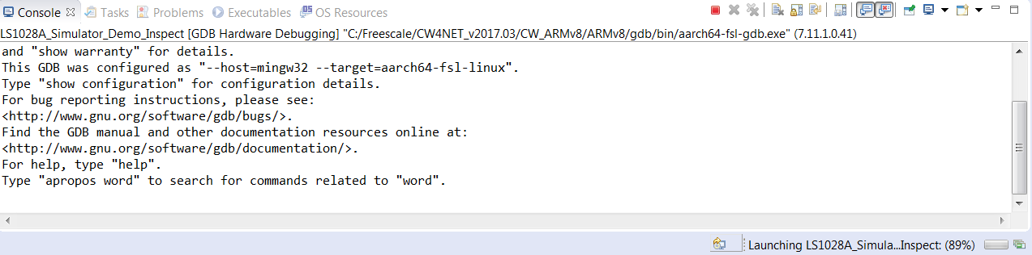
Attaching to Simulator

Slide 8
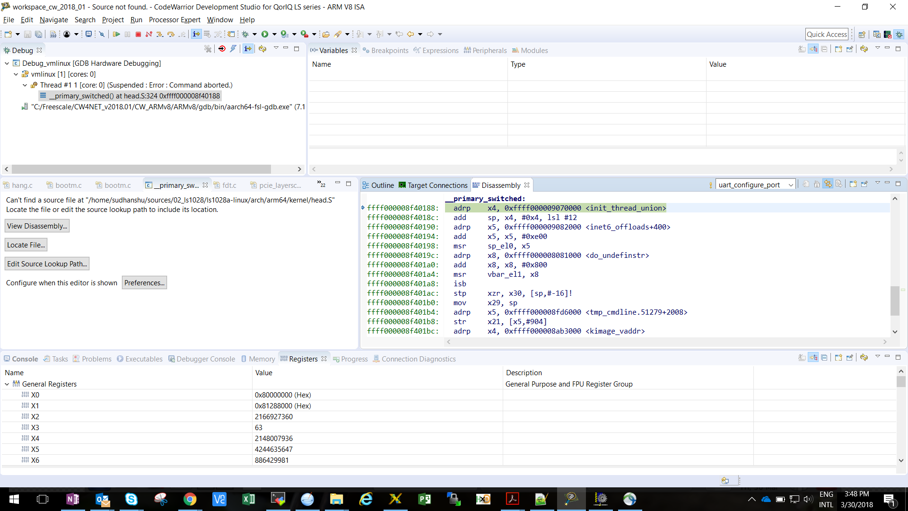
Adding Source Paths p1

Slide 9
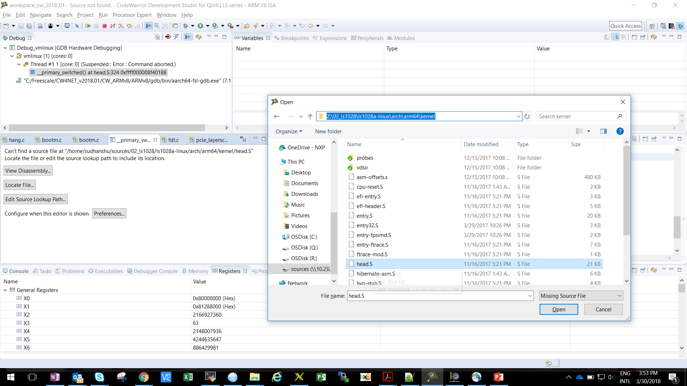
Adding Source Paths p2

Slide 10
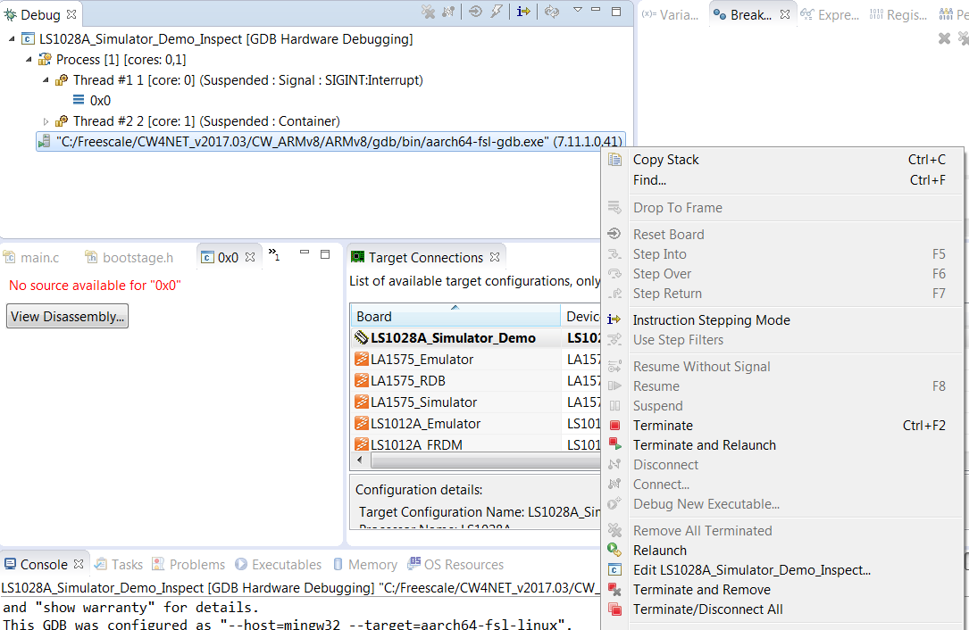
Adding Source Paths p3

Slide 11
Adding Source Paths p4

Slide 12
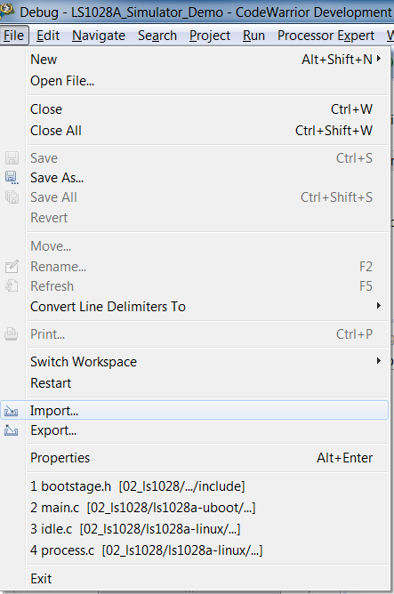
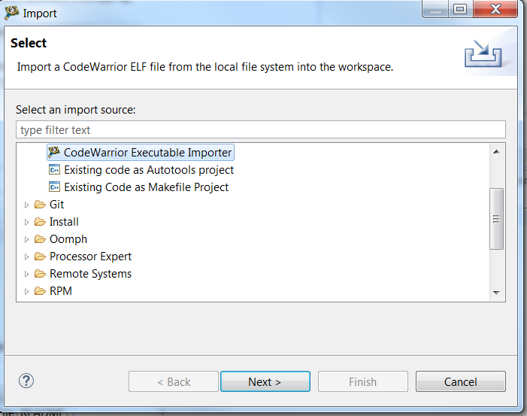
Importing Symbols pg1

Slide 13
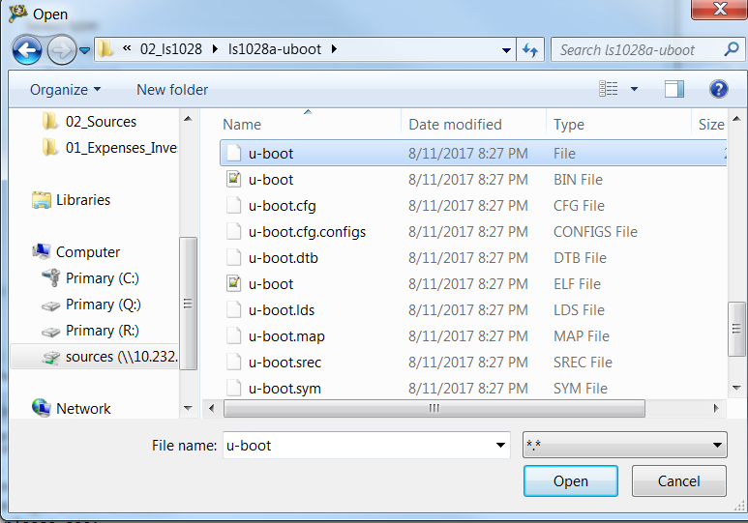
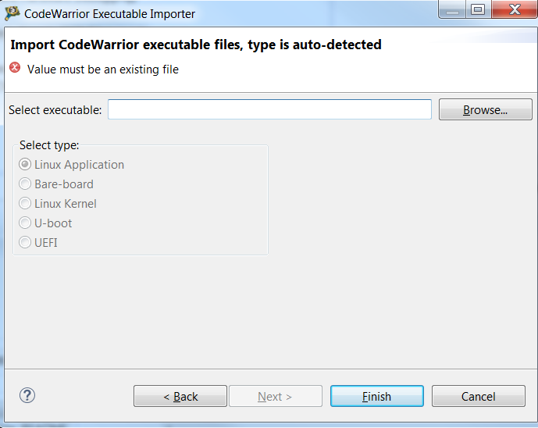
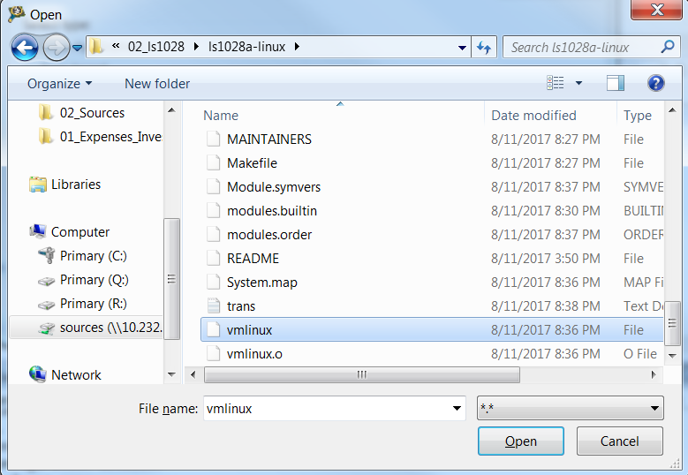
Importing Symbols pg2
Uboot (without any extension)
vmlinux(without any extension)

Slide 14
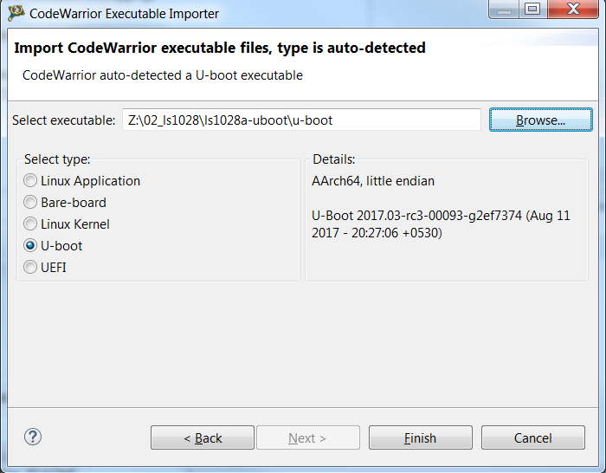
Importing Symbols pg3

Slide 15
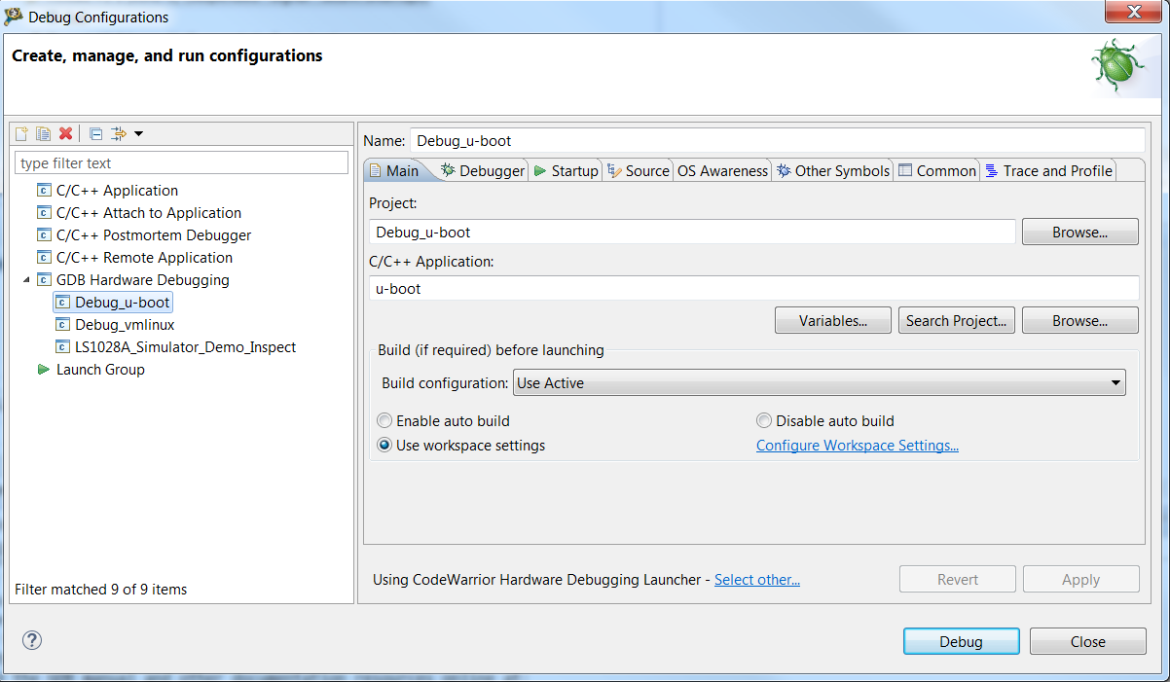
Environment Setting (uBoot / linux) pg1

Slide 16
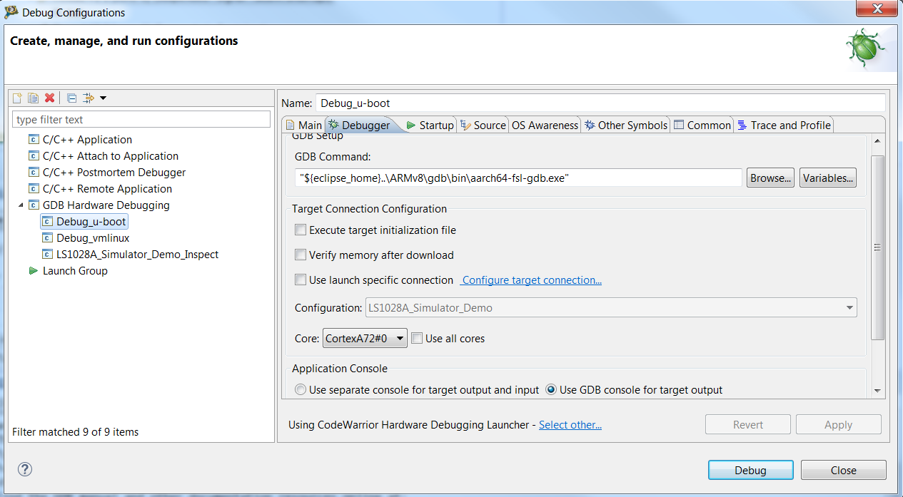

Environment Setting (uBoot / linux) pg2
linux
uBoot

Slide 17
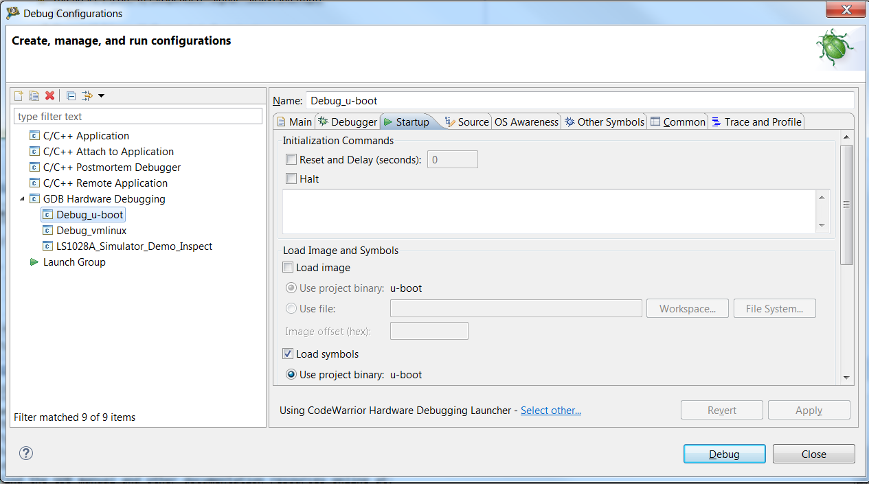
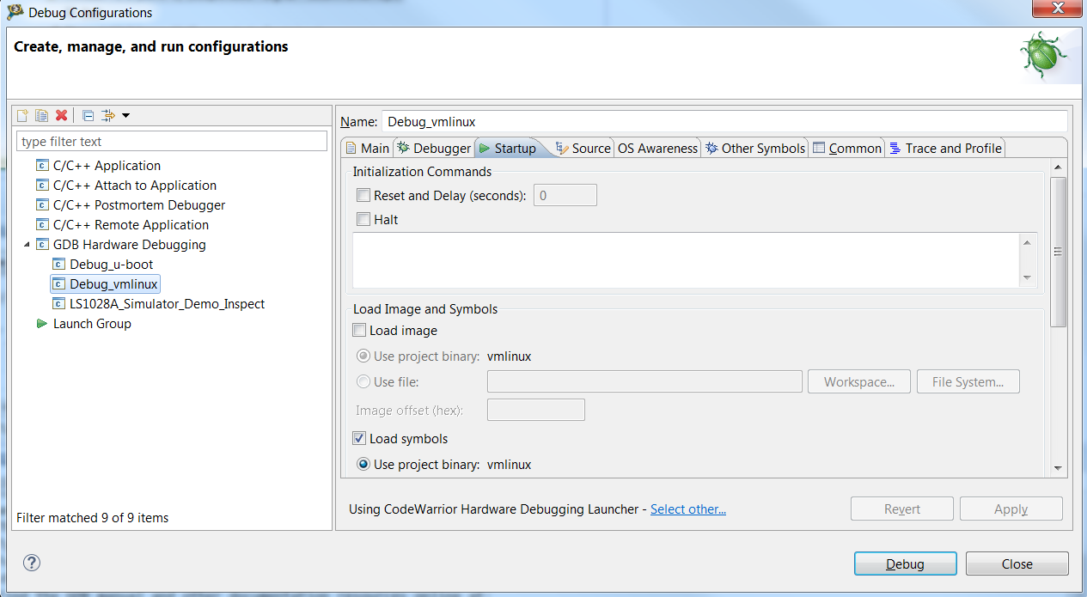
Environment Setting (uBoot / linux) pg3
linux
uBoot

Slide 18
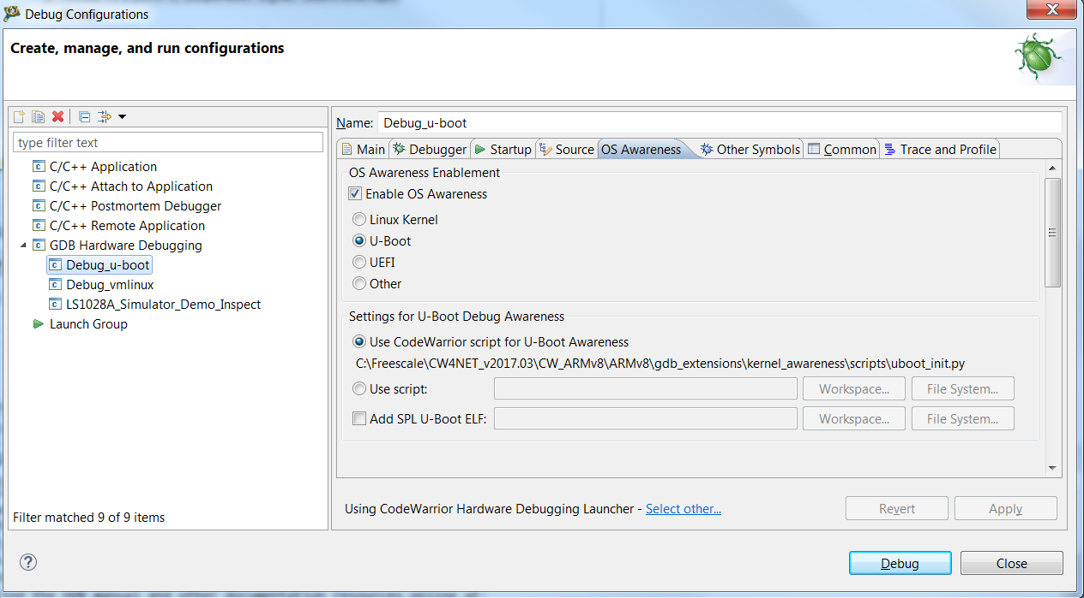
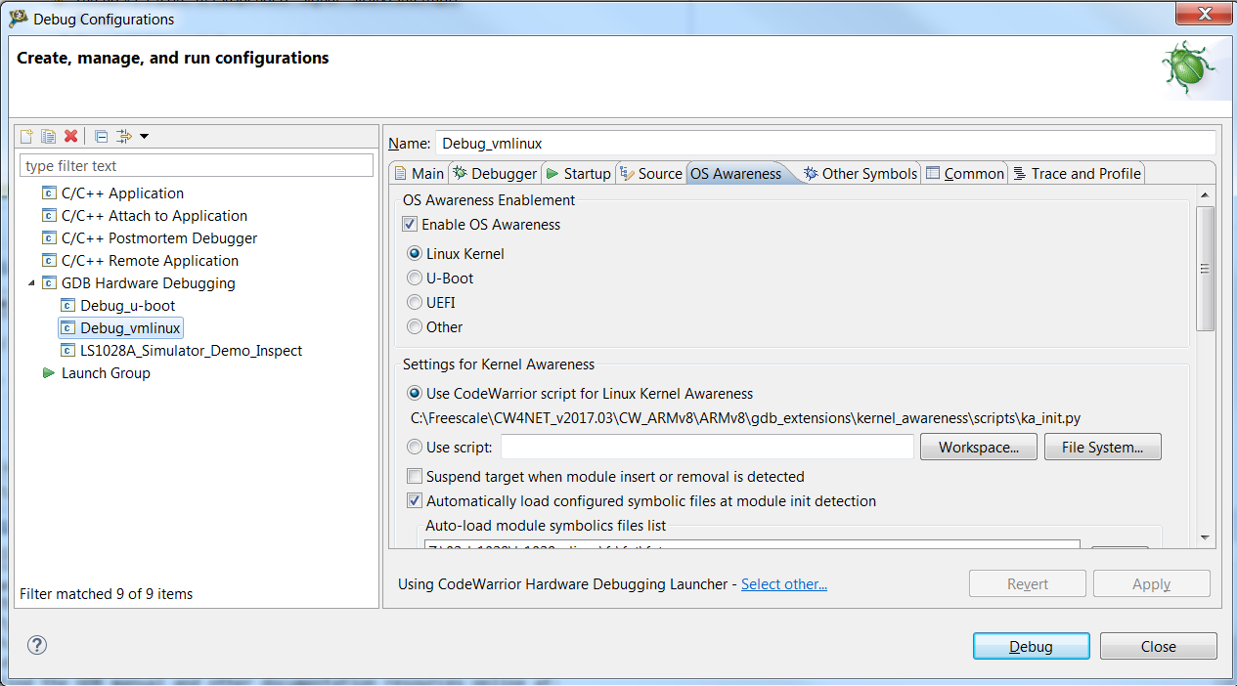
Environment Setting (uBoot / linux) pg4
linux
uBoot

Slide 19
Q n A

Slide 20
Backup Slides

Slide 21
GDB Commands
break relocate_code
cont
break relocate_done
cont
break main_loop

Slide 22
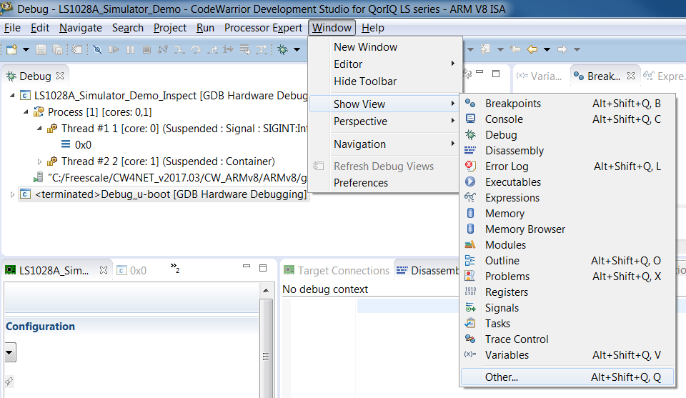
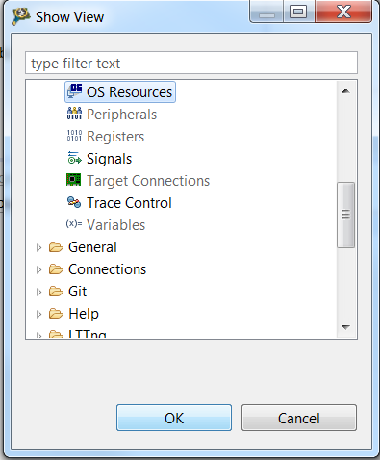
Trouble Shooting Tips
1) If HLL code and Assembly don’t seem to be in sync,
>> check if the ELF file loaded is that of the binary being executed in simulator.

Slide 23
For Debugging User Space Applications
Project to be created – “Remote Application”
Project to be created – “Attach to Application” (Alternate Method)

